Slide 1
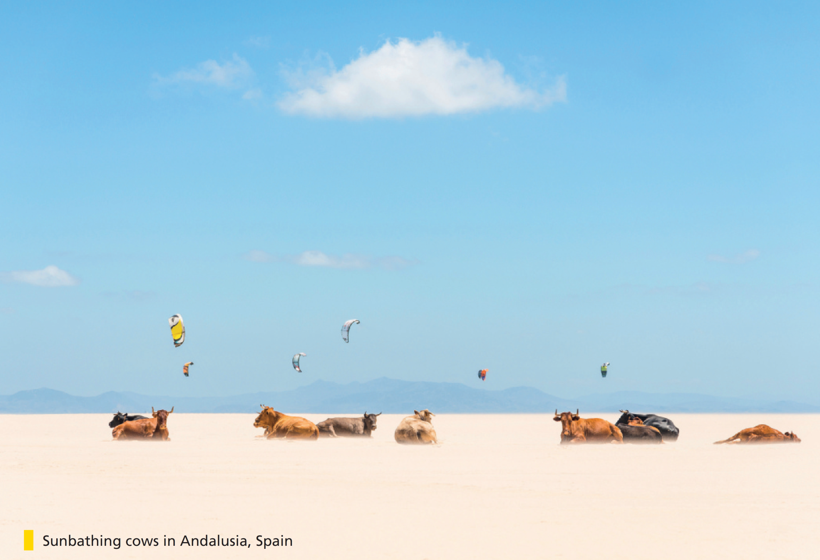

Bringing the world to the classroom and the classroom to life
NGL.CENGAGE.COM/ELT
A PART OF CENGAGE

Slide 2

FEATURES
70 Flexible thinking
How good are you at puzzles and mysteries?
72 Desert art
The mysterious Nasca lines in Peru
74 Lost and found?
Current theories about Amelia Earhart’s disappearance
78 Encounters with a sea monster
A video about strange creatures in the water
Unit 6-p. 69

Slide 3
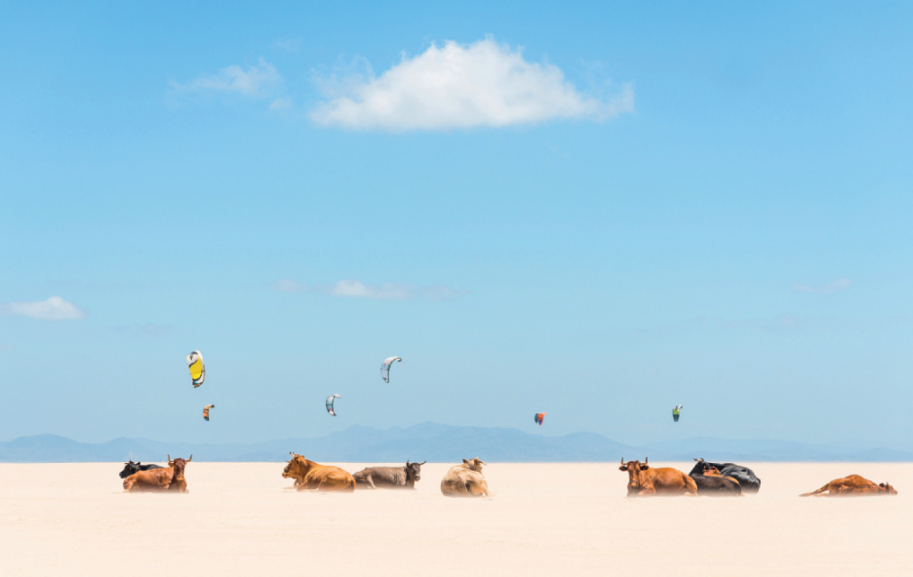

1 Work in pairs. Look at the image. Discuss the questions.
1 Does it look like a painting or a photo?
2 What is happening?
3 What does it make you think about?
4 Do you think the image has a message? What?
Sunbathing cows in Andalusia, Spain
Students’ own ideas
Students may say: the cows look as if they’re in water or clouds. The activity in the sky, which may be parasailing, kiting or parachuting, is not clear.
2 Listen to a conversation about the image. Check your ideas from Exercise 1.
Track 43
1 It’s a photo.
2 Cows are sitting on the sand on a beach while people are parasailing over the beach or sea in the background.
Unit 6p. 69

Slide 4
3 Listen to the conversation again. What do the words in bold refer to?
Track 43
1 Do you think the photographer Photoshopped it?
2 I’m surprised he didn’t frighten them.
3 I can’t make it out.
4 They’re parasailing.
5 It’s a really popular sport there.
1 the photo
2 the cows
3 the background
4 the people (in the photo)
5 in the place where the picture was taken – the coast of Andalusia
Unit 6-p. 69

Slide 5
Script
Track 43
W: What a photo! It’s like a dream. Is it real? I mean, do you think the photographer Photoshopped it?
M: No, it’s totally genuine according to the website. It was taken on a really hot day, so maybe that’s why it looks a bit strange.
W: But I don’t really understand where the cows are.
M: They’re on a beach. It says here the photographer was driving along a coast road in Andalusia and saw some cows lying on the empty beach. He couldn’t get close in his car, so he had to park and walk along the beach in 35 degrees Celsius heat.
W: That sounds horrible. I don’t think I’d do that just to get a shot.
M: I know. I’m surprised he didn’t frighten them – it’s hard to get close to animals.
W: But what‘s going on in the background? I can’t make it out.
M: It looks like people on the beach. I think they’re parasailing. It’s a really popular sport there. It’s always windy on that beach.

Slide 6
4 The woman isn’t sure if the photo is genuine. Why do people sometimes make ‘false’ photos? What about these things?
EXAMPLE ANSWERS
photos: to make them look better, to create a particular artistic effect, to pretend something happened that didn’t bags, clothes, watches, etc.: to make money (students may mention fake designer goods, e.g. fake Louis Vuitton handbags and fake Levi jeans)
eyelashes: to look good – also hair extensions or wigs
money: or order to buy things they wouldn't be able to buy otherwise
paintings: there have been many cases of forgeries of valuable paintings, or of painters making new paintings and pretending they are by a well-known artist.
passport: to make money, pretend to be someone else, e.g. to enter a country illegally
Unit 6-p. 69

Slide 7

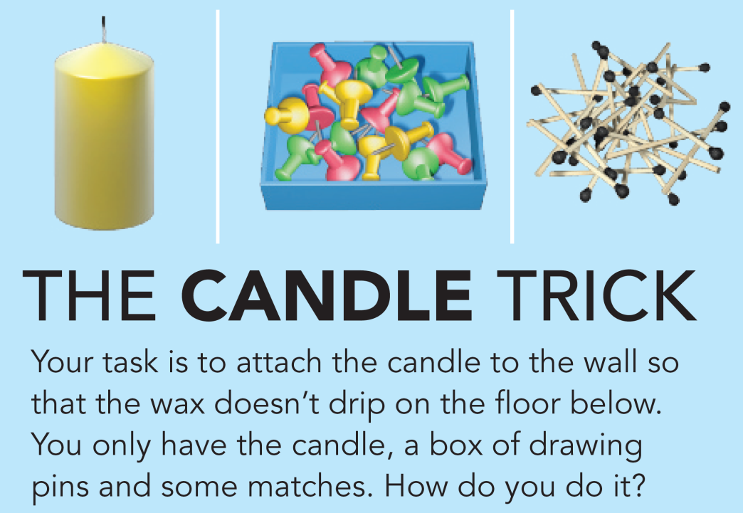
6a Flexible thinking
Listening and reading
1 Work in pairs. Do you like doing puzzles? Read the puzzle and try to find the answer.
2 Compare your ideas for the candle puzzle with another pair. Then turn to page 155 to find out the answer to the puzzle. Was it easy or difficult to work out?
Students refer to Student’s Book page 155.
6a-p. 70

Slide 8
3 Listen to a speaker at a conference. She asks her audience to do the puzzle in Exercise 1. What is the mystery she also talks about?
Track 44
If you offer someone a reward, they work more slowly.
4 Listen again and complete the sentences.
Track 44
1 How good are you at flexible and ____________ thinking?
2 Does the promise of a reward make you work ___________?
3 Imagine I offer half of you some money to do this task more __________.
4 I’m going to see how long it takes you so that we can find out the average ____________.
5 The people with the reward of ___________ will be quicker, right?
6 The people in the first group need more time to find the ___________.
creative
harder
quickly
time
money
answer
6a-p. 70

Slide 9
Script
Track 44
I have two questions for you today. The first: how good are you at flexible and creative thinking? And the second: does the promise of a reward make you work harder?
So, let’s test your flexible thinking. I’m going to give you a task. You have a candle, a box of drawing pins and some matches. The task is to attach the candle to the wall so that the wax doesn’t drip on the floor below. How do you do it? Well, clearly the matches are to light the candle with and we know that drawing pins are for attaching things to other things. But what about the box? Yes, it’s for holding the drawing pins. But you can also use it to hold the candle. And then you attach the box to the wall. Did you get it? Yes? Congratulations, you’re a flexible thinker.
Now, let’s turn to the second question. Imagine I offer half of you some money to do this task more quickly. Not a lot of money, but a fair amount. It’s work – and we all work for money, don’t we? And I tell the other half of you that I’m going to see how long it takes you so that we can find out the average time. What do you think will happen? The people with the reward of money will be quicker, right?
Well, I can tell you the results of this experiment. And it’s the same result every time. The people in the first group – the ones who are offered some money – need more time to find the answer – usually about three minutes longer, in fact. That’s right. It’s a mystery. You offer someone a reward, and they work more slowly. What’s going on?

Slide 10
5 Read the article and find the answer to the mystery the speaker mentioned. When is a reward useful? When is it not useful?
A reward is useful for helping people concentrate on tasks that have a clear set of rules.
A reward is not useful when the task doesn’t have a clear answer and requires flexible or creative thinking.
6a-p. 70

Slide 11

Track 45
People often think that a reward can make people work harder. However, that’s not always true. Basically, it depends on the type of task or work. Rewards are great for making people concentrate and concentration helps with tasks that have a clear set of rules – the kind of thing where you follow the rules to complete the task – for example, doing maths problems or working in computer programming. But concentration doesn’t help with creative and flexible thinking. When the task doesn’t have a clear answer, concentration doesn’t help. In fact, your brain needs to be relaxed and open so that it can look at the problem in different ways. In the workplace, the reward is usually money. So businesses need to think carefully about the relationship between work and pay – because it’s true that people work harder for a reward, but only in some kinds of work.
6a-p. 70

Slide 12
Word focus long
6 Read the sentences and say if the expression with long refers to time (T), distance (D) or something else (S).
T
D
S
T
T
T
S
S
1 How long did it take you to do the puzzle?
2 Is it a long way from here to your house?
3 How long does the essay need to be in the exam?
4 I’m just going for a coffee. I won’t be long.
5 We’ll stay here as long as it takes to finish the job.
6 I love sunbathing. I could do it all day long.
7 I can’t finish this book. It’s just too long.
8 You can stay at my house as long as you don’t mind sleeping on the sofa.
(number of words/lines)
(number of pages/words)
(as long as = on the condition that)
6a-p. 71

Slide 13
7 Work in pairs. Tell your partner about these things. Add follow-up comments.
1 something it took you a long time to do
2 a place a long way away you have visited
3 something you could do all day long
4 something you found too long
A: When I first started learning English, it took me ages to learn how to pronounce ‘daughter’.
B: Oh, I had the same problem with ‘vegetable’!
EXAMPLE ANSWERS
2 A: I visited Australia once – it took a long time to get there
but it was great.
B: Really? I’ve always wanted to go there.
3 A: I could sleep all day long.
B: Oh, I couldn’t. I like to do as much as I can in a day.
4 A: I found Titanic too long – you know, the movie.
B: Yeah. And everybody knew the ship was going to sink!
6a-p. 71

Slide 14
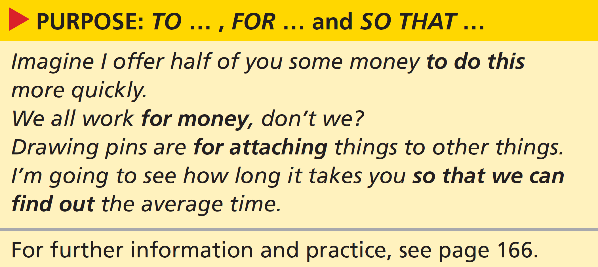

Grammar purpose: to … , for … and so that …
8 Look at the grammar box. Answer the questions.
1 Which verb form follows to?
2 What can follow for?
3 What follows so that?
4 Do the sentences answer the question how or why / what for?
infinitive
a noun, the -ing form of the verb
subject + verb
why / what for
6a-p. 71

Slide 15
9 Look at the article Flexible thinking and rewards. Underline the patterns like those in the grammar box.
Rewards are great for making people concentrate
you follow the rules to complete the task
your brain needs to be relaxed and open so that it can look at the problem in different ways
people work harder for a reward
10 Choose the correct option to complete the sentences.
(1 followed by an infinitive form)
1 We worked together for / to solve the problem faster.
2 The box was useful for / to holding the candle.
3 We looked at the key for / to the answers.
4 I went to the conference so that / to find out more about the brain.
5 I sit near the front so that / to I can hear better.
6 The speaker used pictures for / to make the explanation clearer.
7 Lots of people do Sudoku so that / to keep their brain active.
8 I’m learning Chinese for / so that I can work in China.
2 (followed by an -ing form)
3 (followed by a noun)
4 to (followed by an infinitive form)
5 (followed by a clause with a modal)
6 (followed by an infinitive form)
7 (followed by an infinitive form)
8 (followed by a clause with a modal)
6a-p. 71

Slide 16
11 Match the beginnings of the sentences (1–6) with the endings (a–f). Then complete the sentences with to, for or so that.
1 I want to learn another language so that I can enjoy travelling more.
d
b
c
g
h
e
a
f
1 I want to learn another language
2 My friend called me
3 I write everything down
4 We download the homework to our phones
5 Are you going to London
6 This notebook is
7 Would you like to meet
8 Did you get much chance
2 My friend called me to ask my advice about his course.
3 I write everything down to help me remember it.
4 We download the homework to our phones so that we can study on the bus.
5 Are you going to London for work or on holiday?
6 This notebook is to keep my passwords in.
7 Would you like to meet for a coffee after class?
8 Did you get much chance to speak Italian on your trip?
a a coffee after class?
b ask my advice about his course.
c help me remember it.
d I can enjoy travelling more.
e keep my passwords in.
f speak Italian on your trip?
g we can study on the bus.
h work or on holiday?
6a-p. 71

Slide 17

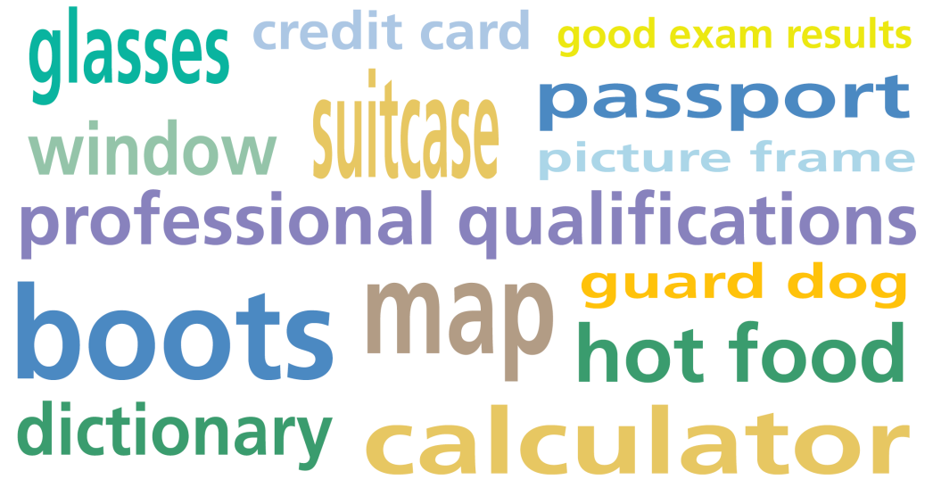
Speaking
12 Work in small groups. Take turns to choose one of the items from the list (without saying which one) and say why we need it. The other students in your group have to try and guess the item, and also add another reason why we need it.
A: We need this to find our way around a strange place.
B: We need it so that we don’t get lost? A map?
A: Yes!
6a-p. 71

Slide 18
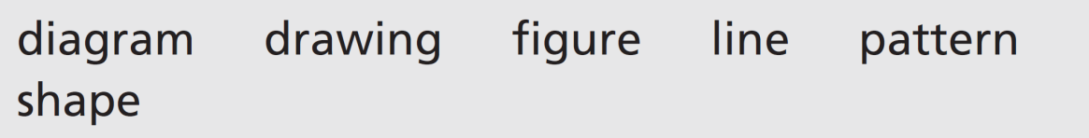
6b Desert art
Vocabulary art
1 Complete the sentences with these words.
1 This looks like a child’s _____________ of a horse.
2 Look at that cloud. It’s in the _____________ of a heart.
3 Can you draw a ten-centimetre straight _____________ without a ruler?
4 I can see a _____________ at the door, but I don’t know who it is.
5 I prefer plain shirts to ones with a colourful _____________.
6 This _____________ of how to cut up a pineapple isn’t very clear.
drawing
shape
line
figure
pattern
diagram
6b-p. 72

Slide 19
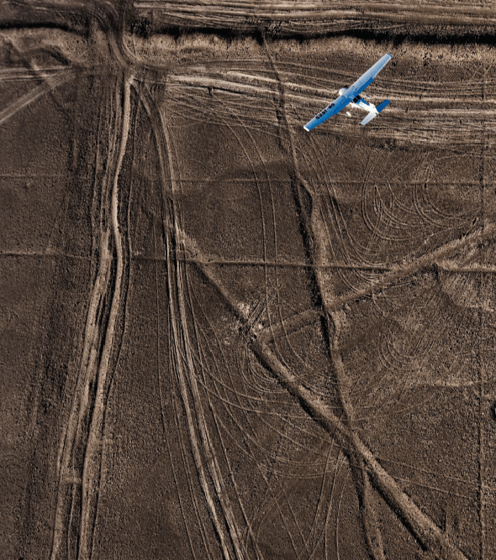
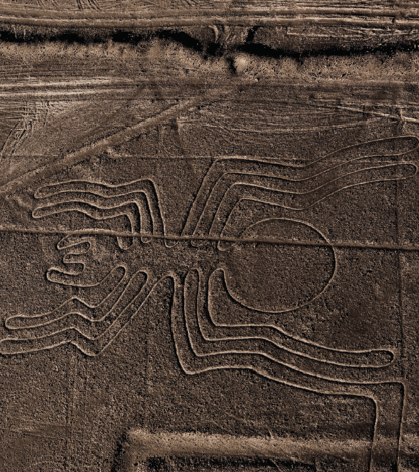
Listening
2 Look at the photo and read the caption. Match the questions (1–3) with the exchanges (a–c).
b
a
c
1 What are they?
2 Where are they?
3 How big are they?
The mysterious Nasca lines in Peru
a ‘They must be in a desert because there aren’t any plants or anything there.’
‘Yes, it looks really dry.’
b ‘They might be roads.’
‘No, they can’t all be roads. That’s clearly a spider.’
c ‘There’s a plane above it.’
‘Yeah, so they must be pretty big.’
6b-p. 72

Slide 20
3 Work in pairs. What do you think the answers to the questions in Exercise 2 are? Listen to an extract from a radio programme and check your ideas.
1 They are enormous drawings on the ground; there are lines and shapes, some are in the shape of animals, some are human figures.
2 in the Nasca desert in southern Peru
3 huge – the biggest of the drawings is about two hundred metres across
Track 46
4 What do you think the purpose of the lines was? Listen to another extract from the radio programme. Complete the sentences.
Track 47
1 The Nasca people couldn’t have seen the ______________ from above.
2 Maria Reiche was convinced that the lines must have been a type of ______________.
3 Other people thought the lines may have been ancient Inca __________.
4 The strangest idea was the lines could have guided creatures from ______________.
5 The Nasca people can’t have known the lines would still be visible ______________ later.
patterns
calendar
roads
space
centuries
6b-p. 72

Slide 21
Script
Track 46
The Nasca lines are enormous drawings on the ground, in the Nasca desert in southern Peru. Most of the lines are just shapes, but about seventy are animals such as a spider, different types of birds, a monkey, or a dog. There are human figures as well. And they are huge – the biggest of the drawings is about two hundred metres across. Altogether, there are hundreds of these drawings and they are in an area of about eighty kilometres across.
The lines were made by the Nasca people over a period of time starting about two thousand years ago. They moved the brown stones that cover the desert and so showed the white ground underneath. You can still see the stones along the edges of the lines.

Slide 22
Script
Track 47
The mysterious thing about the lines is that they only became clear about one hundred years ago when air travel began. But the Nasca people couldn’t have seen the patterns from above. So the question is how, and indeed why, did they make them?
One of the first people to study the lines was an archaeologist called Maria Reiche. She became convinced that the lines must have been a type of calendar. Other people thought they may have been ancient Inca roads. The strangest idea was that they could have guided creatures from space!
One of the other mysterious aspects of the Nasca people is that although this region of Peru is one of the driest places on Earth, they built a successful society there. How could they have done this without water? Well in fact, there is a river in the mountains. It goes underground for many kilometres before it reappears on the surface. Some people think that this might have seemed mysterious to the Nasca people, and so the lines were part of traditional or religious beliefs linked to the water. Whatever the explanation, one thing is for sure: the Nasca people can’t have known that the lines would still be visible centuries later.

Slide 23
5 Which theory do you think is most likely? Compare your ideas with your class.
EXAMPLE ANSWERS
In order of most to least likely (in this writer’s opinion):
1 part of traditional or religious beliefs linked to the water
2 a type of calendar (Reiche’s idea)
3 ancient Inca roads
4 a guide for creatures from space!
1b-p. 12

Slide 24
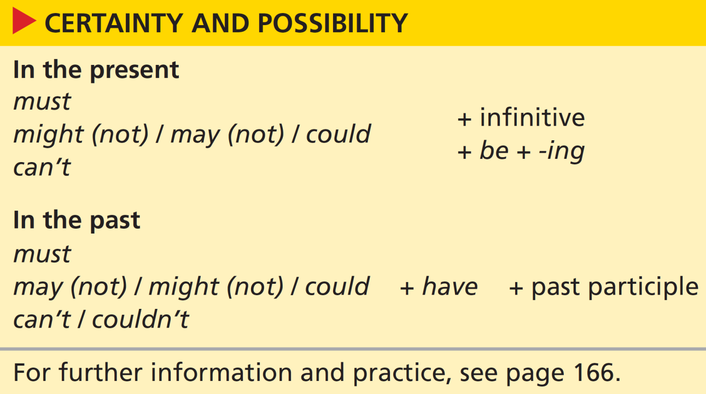
Grammar certainty and possibility
6 Look at the grammar box. Underline the patterns in the sentences in Exercises 2 and 4.
See next slide for answers
7b-p. 72

Slide 25
Exercise 6
In Exercise 2, examples match the patterns for expressing certainty and possibility in the present (modal + infinitive). In Exercise 4, examples match the patterns for expressing certainty and possibility in the past (modal + have + past participle).
Exercise 2:
a ‘They must be in a desert …
b ‘They might be roads.’
‘No, they can’t all be roads.’
c ‘Yeah, so they must be pretty big.’
Exercise 4:
1 The Nasca people couldn’t have seen the patterns from above.
2 Maria Reiche was convinced that the lines must have been a type of calendar.
3 Some people thought the lines may have been ancient Inca roads.
4 The strangest idea was the lines could have guided creatures from space.
5 The Nasca people can’t have known the lines would still be visible centuries later.

Slide 26
7 Look at the grammar box again. Choose the correct option to complete the rules.
1 We use must to say if something is or was possible / probable.
2 We use might, may and could to say if something is or was possible / probable.
3 We use can’t and couldn’t to say if something is or was impossible / improbable.
6b-p. 72

Slide 27
8 Complete the sentences with present modal forms.
1 This drawing has eight legs. Insects have six legs. So it _______________ an insect.
2 ‘What are the straight lines?’ ‘I’m not sure. They ____________________ paths.’
3 ‘What’s the plane doing?’ ‘It ____________________ photographing the lines, but I can’t see a camera.’
4 It’s summer in Europe now, so it ____________________ winter in Peru.
5 I’d like to walk along the lines, but they ____________________ let people do that.
6 The figures are so big a plane ____________________ the only way to see them properly.
can’t be
might/may/could be
might/may/could be
must be
mightn’t/may not
must be
6b-p. 73

Slide 28
9 Complete the sentences about the Nasca lines with the past modal form.
1 The lines ______________________ something very special to the Nasca people. (must / mean)
2 We know water ______________________ easy to find. (can’t / be)
3 The water in the area ______________________. (might / disappear)
4 People ______________________ the drawings for fun. (might / make)
5 The animal drawings ______________________ roads. (couldn’t / be)
6 The animals ______________________ in the region. (must / live)
7 The Nasca people ______________________ simple tools. (could / use)
8 People ______________________ the lines carefully. (must / look after)
must have meant
can’t have been
might have disappeared
might have made
couldn’t have been
must have lived
could have used
must have looked after
6b-p. 73

Slide 29
10 Complete the conversations using the correct option and the verb in brackets. Use a present or past modal form.
1 A: Why hasn’t my sister returned my phone call?
B: Well, she can’t / may _________________ have forgotten (forget).
She never forgets things.
2 A: Is Sandra here? I haven’t seen her today.
B: Yes, she’s here. She can’t / might _________________ (get) a coffee.
3 A: Who’s Tom talking to?
B: It may / must _________________ (be) his father. He said, ‘Hi, Dad.’
4 A: Why did the plane arrive late?
B: I don’t know. It could / mightn’t _________________ (take off) late.
5 A: Is Joe around? We’ve got a meeting.
B: Well, his computer is still on, so he can’t / must _________________
(go out).
6 A: Why is Phil wearing odd socks?
B: He can’t / might _________________ (get dressed) in a hurry this
morning.
have forgotten
be getting
be
have taken off
have gone out
have got dressed
6b-p. 73

Slide 30
11 Pronunciation weak form of have
a Listen to the conversations from Exercise 10 and check your answers. Is have in past modals pronounced /hæv/ or /həv/? Is the h pronounced?
Track 48
Have is an auxiliary verb. It is pronounced /(h)əv/ in these
sentences.
b Work in pairs. Read the conversations aloud. Pay attention to your pronunciation of have.
6b-p. 73

Slide 31
Speaking
12 Work in pairs. Look at the comments and think of situations when you might say these things.
1 You must have forgotten to plug it in.
2 They may have lost your application.
3 They must be at home.
4 You might have dropped it on the way here.
5 He must have forgotten to pick it up.
6 She can’t have finished so quickly.
7 They might be stuck in traffic.
8 You must have spent it on something.
See next slide for answers
6b-p. 73

Slide 32
Exercise 12
EXAMPLE ANSWERS
1 An electrical device failed to work (e.g. washing machine, phone) or ran out of battery (e.g. phone, tablet, baby monitor).
2 Somebody has not been invited for interview or not received a reply of any sort to something (e.g. a job) they applied for.
3 arriving a house with lights on; arriving at an event to find somebody hasn’t come
4 something lost – a bag, a key, a phone
5 ‘It’ could be a letter or package. ‘He’ didn’t stop at the post office to get it.
6 Somebody is sitting in an exam room but not writing anything.
7 Somebody is late.
8 Somebody can’t find some money – their wallet seems empty.

Slide 33
13 Imagine you are in the situations in Exercise 12. Have conversations that include the comments. Take turns to begin.
A: Oh no! The battery’s flat on my phone
B: You must have forgotten to plug it in. Do you want to use mine?
A: Thanks, but the number I need is in my contacts – I can’t remember it.
6b-p. 73

Slide 34
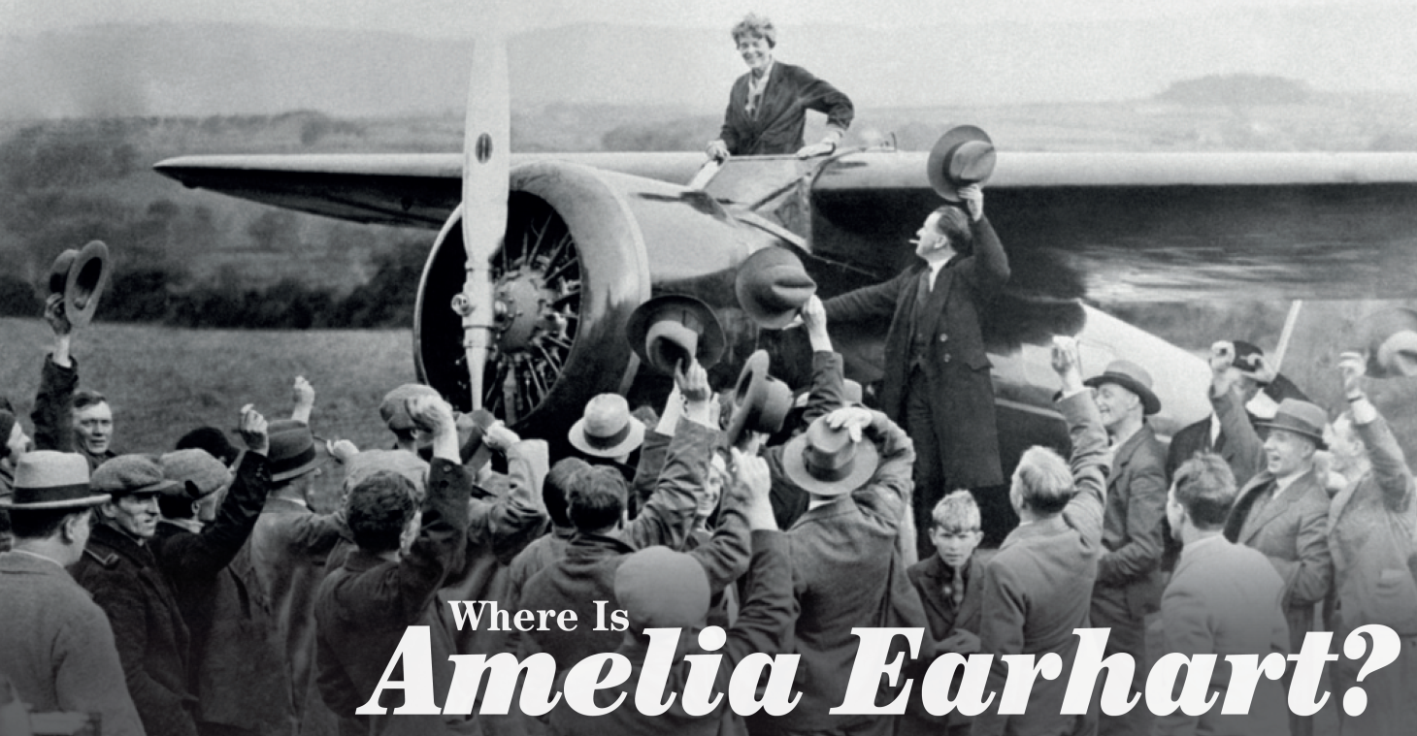
6c Lost and found?
Reading
1 Look at the photo and the caption. Which of these statements could be true?
1 Amelia Earhart was a famous pilot.
2 She flew across the Atlantic Ocean.
3 In the photo, she’s just landed her plane.
4 She lived until she was one hundred years old.
2 Read the first article quickly. Check your ideas from Exercise 1.
Statements 1 and 2 are true.
Statement 3 could be true, but people are waving so it’s more likely to be false.
Statement 4 isn’t true: she never arrived on the island of Howland, so we can assume she died on her flight there – and she wasn’t 100 years old when she set off.
6c-p. 74

Slide 35
Track 49
Three Theories by John Roach
Amelia Earhart, the first woman to fly solo across the Atlantic Ocean, was attempting a round-the-world flight in 1937. She planned to land on the tiny Pacific Ocean island of Howland just north of the equator. She never arrived. Exactly what happened to her and her navigator, Fred Noonan, is still one of aviation’s greatest mysteries. Researchers have spent millions of dollars investigating the case and several books have been published that look at the different theories.
6c-p. 75

Slide 36
Track 49
The official US opinion is that Earhart ran out of fuel and crashed in the Pacific Ocean. The radio records from a US Coast Guard ship suggest that she must have been near Howland when contact was lost.
Another theory says that Earhart could have landed and later died on a different island, called Nikumaroro. Nobody lived there.
And another theory says she was captured while on a secret mission to the Japanese-controlled Marshall Islands in the North Pacific and eventually returned to the USA with a new identity.
6c-p. 75

Slide 37
3 Read the second article. Answer the questions.
1 What is the theory talked about in the article?
2 Which modern scientific technique might give an answer to the Earhart mystery?
3 If the new project is successful, what will it prove?
4 What is the biggest problem for the researchers on the new project?
1 The theory that Earhart landed on Nikumaroro.
2 DNA sampling
3 It will prove that a bone found on the island of Nikumaroro is Earhart’s – and that she died there.
4 About 99 per cent of the genome is identical among all humans, so the team needs to have enough material to show that the DNA belongs to Earhart and nobody else.
6c-p. 74

Slide 38
Lost and found?
The missing pilot
Track 50
by Ker Than
Amelia Earhart’s dried saliva could help solve the mystery of the aviator’s 1937 disappearance. Scientists plan to take samples of her DNA from letters she wrote and create a genetic profile. This could be used to test recent suggestions that a bone found on the South Pacific island of Nikumaroro is Earhart’s.
Justin Long is a Canadian whose family is financing part of the DNA project. He makes the point that at the moment, anyone who finds pieces of bones can say that they are Amelia Earhart’s remains. According to Long, Earhart’s letters are the only existing items that are definitely hers and that might contain her DNA. The remains of Earhart, her navigator Noonan and their twin-engine plane were never found. But in 2009, researchers with the International Group for Historic Aircraft Recovery discovered a piece of bone on Nikumaroro, which they believed might have been from one of Earhart’s fingers. However, some scientists have suggested the Nikumaroro bone isn’t human at all but may be from a turtle.
6c-p. 75

Slide 39
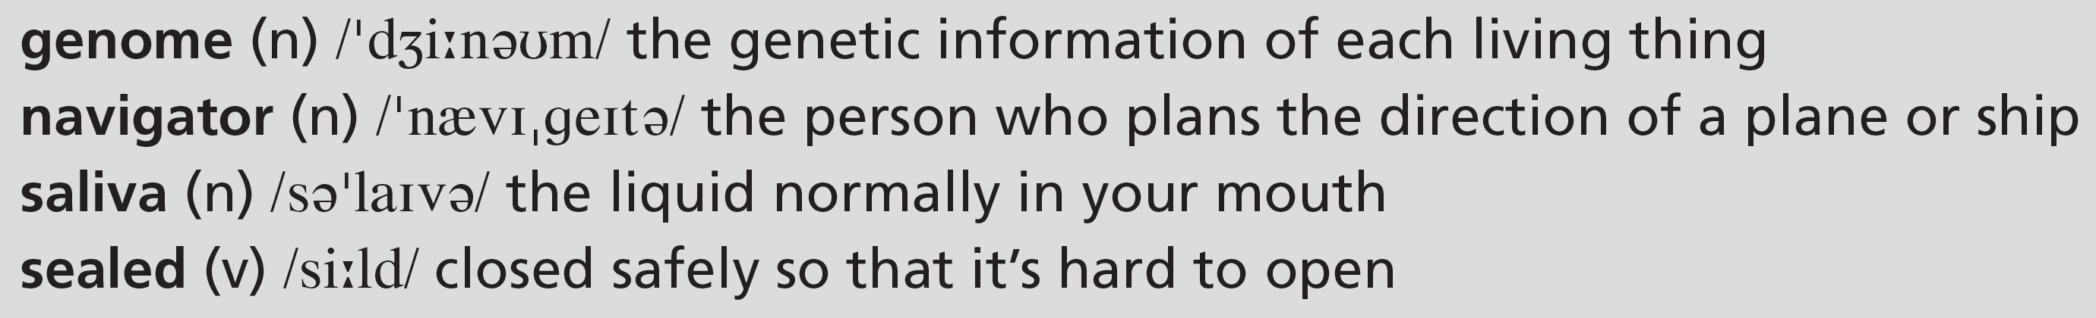
Track 50
The new Earhart DNA project will be organized by Dongya Yang, a genetic archaeologist at Simon Fraser University in Canada. Yang will work on four letters Earhart wrote to her family. More than 400 of Earhart’s letters still exist today. Much of Earhart’s correspondence was dealt with by her secretary. However, with the four personal letters, it is believed that Earhart must have sealed the envelopes herself.
Meanwhile, geneticist Brenna Henn of Stanford University, USA said she knows of no other case where DNA has been collected from old letters. The problem is that the envelopes probably don’t contain much DNA. The project needs a big sample to distinguish between Earhart’s DNA and that of other living people because about 99 per cent of the genome is identical among all humans. To make sure that the DNA from the letters belonged to Earhart, the team will compare it to DNA from Earhart’s relatives who are still alive and also DNA extracted from another letter, written by Earhart’s sister.
6c-p. 75

Slide 40
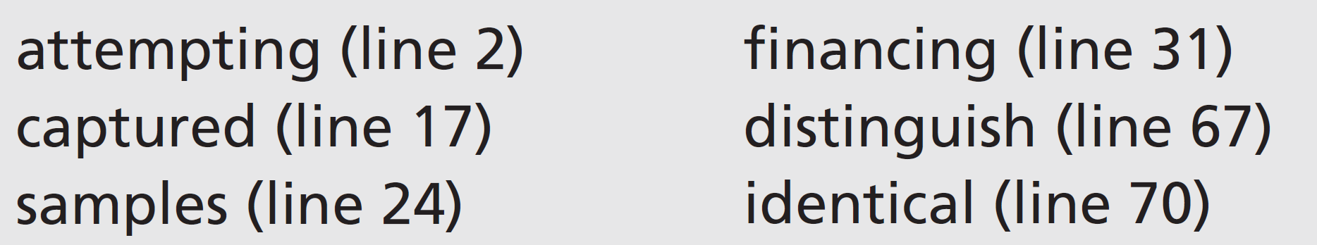
4 Find these words in the articles. Look at how the words are used and try to guess their meaning. Then replace the words in bold in the sentences (1–6) with these words.
1 My grandparents are paying for my studies.
2 It’s easy to see the difference between a leg bone and an arm bone.
3 The doctor took small amounts of my blood to do tests.
4 The soldier was caught and put in prison by the enemy.
5 The cyclist is trying to break the world record.
6 The two brothers look exactly the same to me.
financing
distinguish
samples
captured
attempting
identical
6c-p. 74

Slide 41
5 Work in groups. Discuss the questions.
1 The piece of bone ‘might have been from one of Earhart’s fingers’. Are there any other possibilities?
2 Is it certain that any saliva on the envelopes is Earhart’s? Why? / Why not?
3 Do you think the project will be successful?
1 The piece of bone may be from a turtle.
2 It isn’t certain because much of Earhart’s correspondence was dealt with by her secretary, so she may have sealed the envelopes.
3 Students’ own answers
6 Work in pairs. Complete the summary.
The new project aims to provide a way of testing
1 ________________________________. The success of the project depends on several things. Firstly, that the bone is from a 2 _____________________, not a turtle. Secondly, that Earhart’s saliva still exists on 3 ____________________________________. And thirdly, that there is enough saliva to 4 ________________________________.
claims about Earhart’s remains
human
the envelopes of letters that she sent
give them a DNA sample
6c-p. 74

Slide 42
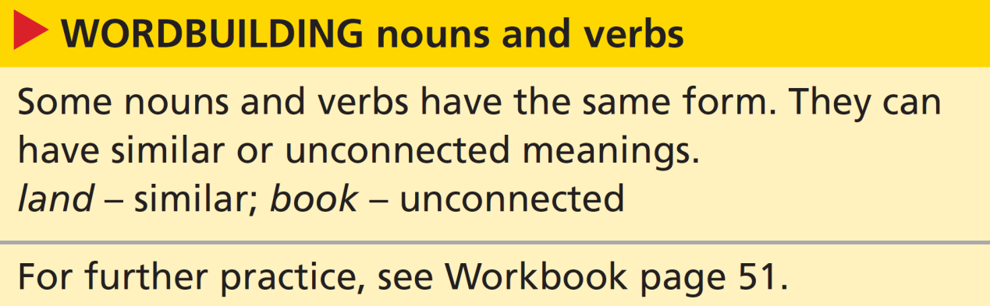
Wordbuilding nouns and verbs
7 Look at the wordbuilding box. Find these words in the two articles. Are they used as nouns or verbs?
1 fly (line 1)
2 land (line 3)
3 books (line 8)
4 records (line 11)
5 contact (line 13)
6 plan (line 23)
7 test (line 26)
8 remains (line 35)
fly – verb
contact – noun
land– verb
plan – verb
books – noun
test – verb
records – noun
remains – noun
6c-p. 74

Slide 43
8 Look at the same words in these sentences. Is the meaning similar to the meaning of the word in Exercise 7?
1 Have you got any plans for the weekend?
2 We always book our hotel rooms in advance.
3 I tried to contact them yesterday without success.
4 Did Amelia Earhart hold any flying records?
5 Everyone did badly in yesterday’s English test.
1 yes (to plan something is similar to make a plan)
2 no (to book = to reserve; a book = something you read)
yes (contact = when you call or signal someone so they know you are there; to contact = to call, send a signal or write to someone – so they are similar)
4 no (records = (countable) information about something that is written down or stored on computer, film etc. so that it can be looked at in the future; a record = an achievement, e.g. Usain Bolt has the 100 metres world record)
5 no (to test = to find out if something works; a test = something you do to find out how good you are)
6c-p. 74

Slide 44
Critical thinking speculation or fact?
9 Read the definitions. Then decide if the sentences from the articles report speculation (S) or fact (F).
Speculation is having a theory or guessing about something.
Facts are items of information that we can check, or show to be true or not true.
1 Amelia Earhart […] was attempting a round-the-world flight in 1937.
2 Earhart could have landed ... on a different island.
3 The problem is that the envelopes probably don’t contain much DNA.
4 About 99 per cent of the genome is identical among all humans.
F
S
S
F
1 (we can prove this – from news reports, news reels or history books)
2 (just an idea – no proof has been found)
3 (this is just an idea, confirmed by the use of ‘probably’)
4 (established scientific fact)
6c-p. 74

Slide 45
10 Find one more fact and one more speculation in the articles. Then work in pairs. Do you agree with your partner’s choices?
EXAMPLE ANSWERS
Fact: Researchers have spent millions of dollars investigating the case …
Speculation: … she was captured while on a secret mission to the Japanese-controlled Marshall Islands in the North Pacific …
Speaking
11 Work in groups. Think of at least three news stories you have heard about recently. Suggest as many reasons as you can for what has happened.
A: Did you see that … isn’t going to make any more films?
B: I know! Do you think he/she could be ill?
6c-p. 74

Slide 46
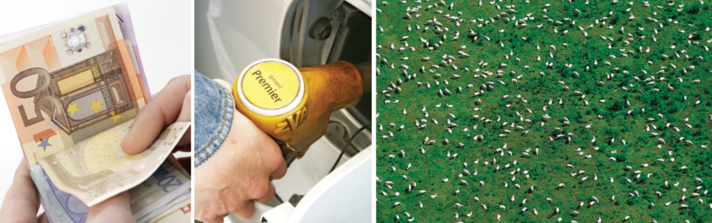



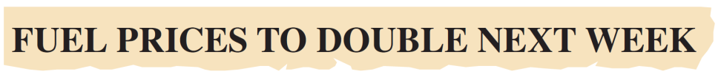

6d You must be joking!
Real life reacting to surprising news
1 Listen to three conversations about news items. Choose the best headline (a or b) in each case.
1 a
b
2 a
b
3 a
b
Track 51
6d-p. 76

Slide 47
2 Can you remember? Answer the questions for each story.
1 What is the problem?
2 Does the second speaker believe the first speaker?
3 What is the date?
Story 1:
1 Sheep are reflecting the sun back into the atmosphere because they are white and causing global warming.
2 no
3 1 April
Story 2:
1 Blue twenty-euro notes are forged.
2 yes
3 1 April
Story 3:
1 The young woman has filled her father's car with petrol – but it’s a diesel car.
2 yes
3 1 April
6d-p. 76

Slide 48
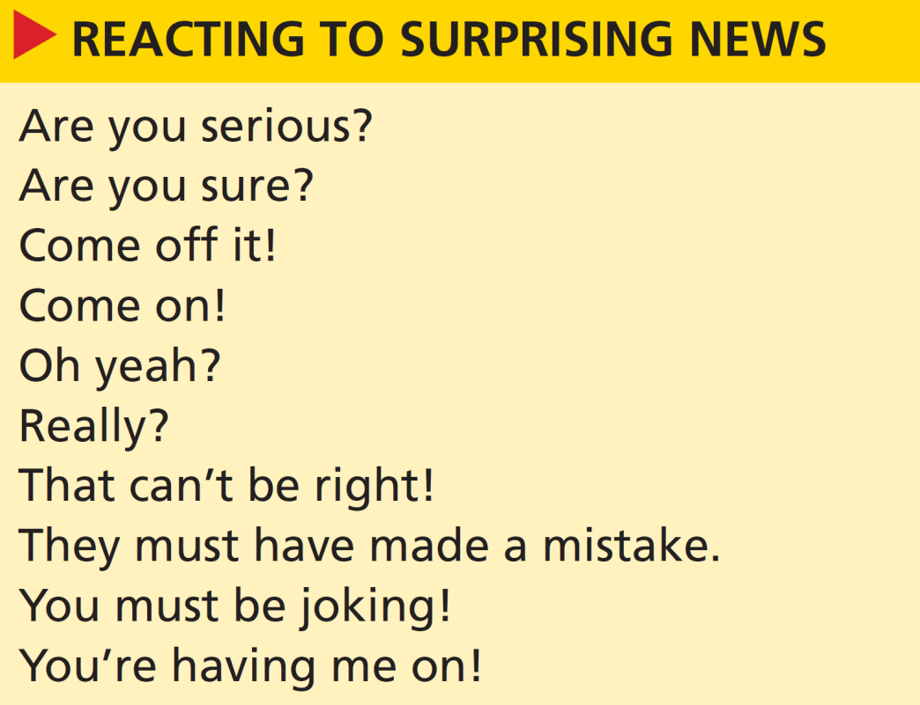
3 Look at the expressions for reacting to surprising news. Listen to the conversations again. Put the expressions in order (1–9). There is one extra expression.
Track 51
9
6
2
1
8
4
7
5
3
4 April Fools’ Day (1 April) is a day when people try to trick each other in many countries. Do you do anything similar in your country?
Students' own answers
6d-p. 76

Slide 49
Script
Track 51
1
A: Did you hear that story about the sheep?
B: No, I don’t think so. What was it about?
A: Apparently, they reflect the sun back into the atmosphere, because they’re so white.
B: Oh yeah?
A: And then the heat from the sun gets trapped, so it makes everything hotter. So they think sheep cause global warming.
B: Come off it!
A: Well, that’s what it says in the paper today.
B: You’re having me on!
A: It does – here, look.
B: Hmm, that can’t be right! Hang on a minute, what’s the date today?

Slide 50
Script
Track 51
2
C: Let me have a look at those twenty-euro notes for a moment.
D: Why?
C: The blue ones are no good – they’re forged.
D: You must be joking! All twenty-euro notes are blue!
C: Not the real ones.
D: Are you sure?
C: I’m absolutely positive. The girl at the travel agent’s told me. It was on the news last night.
D: They must have made a mistake … oh no, and we’ve just changed all this money! What are we going to do?
C: I don’t know … but it is 1 April today…
D: Oh, honestly! I really believed you!

Slide 51
Script
Track 51
3 D = daughter, F = father
D: Dad, did you see the news about petrol prices? They’ve gone down to almost half the price.
F: Really? How come?
D: I don’t know. But anyway, I’ve put petrol in the car.
F: Great … hold on … did you say petrol?
D: Yeah.
F: Are you serious? The car uses diesel, not petrol!
D: I know, but petrol is so much cheaper!
F: Yes, but …
D: I’m sorry, did I do something wrong?
F: Diesel engines don’t work with petrol, you must know that! Oh, this is going to cost me a fortune.
D: Dad?
F: Yes?
D: How do you suppose I managed to drive the car home, then? April Fool! It’s 1 April!

Slide 52
5 Pronunciation showing interest and disbelief
a Listen to these expressions for reacting to surprising news. Notice how the speaker’s intonation rises to show interest and falls to show disbelief.
Track 52
1 Oh yeah?
2 Come off it!
b Listen to the other expressions for reacting to surprising news. Repeat the expressions.
Track 53
c Work in pairs. Take turns to respond to these statements.
1 I’m setting off on a round-the-world trip on Monday.
2 A meteorite has crashed to Earth in the middle of Berlin.
3 I found a wallet full of money in the street this morning.
4 Biologists have discovered a parrot that can speak three languages.
5 I’m starting a new job tomorrow.
6d-p. 76

Slide 53
6 Work in pairs. Choose one of the other April Fools’ Day headlines from Exercise 1. Decide what the hoax – the trick – is. Make notes about the main points of the story. Invent as many details as you wish. Practise telling the story with your partner.
7 Work with a new partner. Take turns to listen and react to your stories. Use the expressions for reacting to surprising news to help you. Don’t forget to show interest or disbelief with your intonation.
6d-p. 76

Slide 54
6e In the news
Writing a news story
1 Work in pairs. Read the news story. Do you think it is true or not? Explain your reasons to your partner.
It's a true story.
2 Writing skill structuring a news story
a Read the introductory sentence in the news story again. Answer the questions.
1 What happened?
2 Who was involved?
3 Where did it happen?
1 A woman accidentally cut through an underground cable.
2 an elderly Georgian woman
3 in Georgia
6e-p. 77

Slide 55
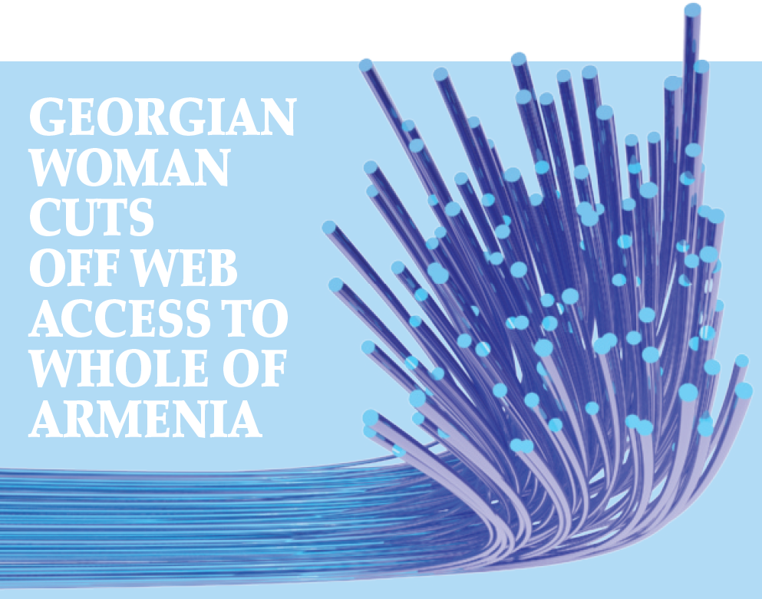
An elderly Georgian woman has accidentally cut through an underground cable and cut off internet services to a whole country, Armenia.
The woman, 75, was digging for metal near the Georgian capital Tbilisi and her spade damaged the cable. Unfortunately, Georgia provides 90 per cent of Armenia’s internet. Unfortunately, Georgia provides 90 per cent of Armenia’s internet. Web users
in the nation of 3.2 million people were left with no internet for up to five hours. Large parts of Georgia and some areas of Azerbaijan were also temporarily affected. The damage was discovered by an automatic system and a security team immediately went to the place where the cable was cut. The cable is protected, but apparently landslides or heavy rain may have left it exposed on the surface. The woman, called ‘the spade-hacker’ by local newspapers, was arrested for damaging property. She may have to spend up to three years in prison.
6e-p. 77

Slide 56
b Read the main paragraph and find:
1 how the woman cut the cable.
2 four things that happened after she cut the cable.
3 two pieces of background information.
1 She was digging for metal when her spade damaged the fibre-optic cable.
2 Internet services to Armenia were cut off; A monitoring system detected the damage; A security team went to the sport; The woman was arrested.
3 Possible answers could include: The woman was digging for metal; Georgia provides 90 per cent of Armenia’s internet; Web users in the nation of 3.2 million people were left twiddling their thumbs; The cable is protected, but apparently landslides or heavy rain may have left it exposed on the surface; The woman has been called ‘the spade-hacker’ by local media.
c Read the main paragraph again. How are the events and background details organized?
The main events are in chronological sequence.
Background information is inserted after the main event it relates to.
6e-p. 77

Slide 57
3 Vocabulary -ly adverbs in stories
a Find these adverbs (1–5) in the story. Then match the adverbs with their meanings (a–e).
b
e
c
a
d
1 accidentally
2 unfortunately
3 temporarily
4 immediately
5 apparently
a at once
b by mistake
c for a short time
d it seems
e we are sorry to say
6e-p. 77

Slide 58
b Cross out any options which are not possible.
1 Apparently, / Quickly, this type of incident is increasing in Georgia.
2 Fortunately, / Incredibly, nobody was hurt.
3 Internet services were amazingly / gradually restored across the region.
4 Coincidentally, / Rapidly, internet services also failed in other regions last week.
5 Software providers say hackers deliberately / sadly damaged the service.
6 Hopefully, / Slowly, the police will release the woman because of her age.
both are possible
c Work in pairs. Decide which of the sentences in Exercise 3b fit into the story and where they fit.
3 Internet services were gradually restored across the region.
This could go after ‘… temporarily affected.’
6 Hopefully, the police will release the woman because of her age.
This could go after ‘… three years in prison.’
6e-p. 77

Slide 59
4 You are going to write an April Fools’ story or a news story that is not true. This can be invented or it can be a story you have heard. First, make notes about the main events and the background details of the story. Think about what? who? where? and also why? and how?
5 Write an introductory sentence to summarize the story. Then number your notes in the order you will write about them. Include at least three adverbs where appropriate.
6 Work on your own. Write your story in about 150–200 words. Write an interesting headline.
7 Work with a new partner. Exchange stories. Use these questions to check your partner’s story.
• Did the headline make you interested in reading the story?
• Are the facts of the story clear?
• Do you think the story is true?
6e-p. 77

Slide 60
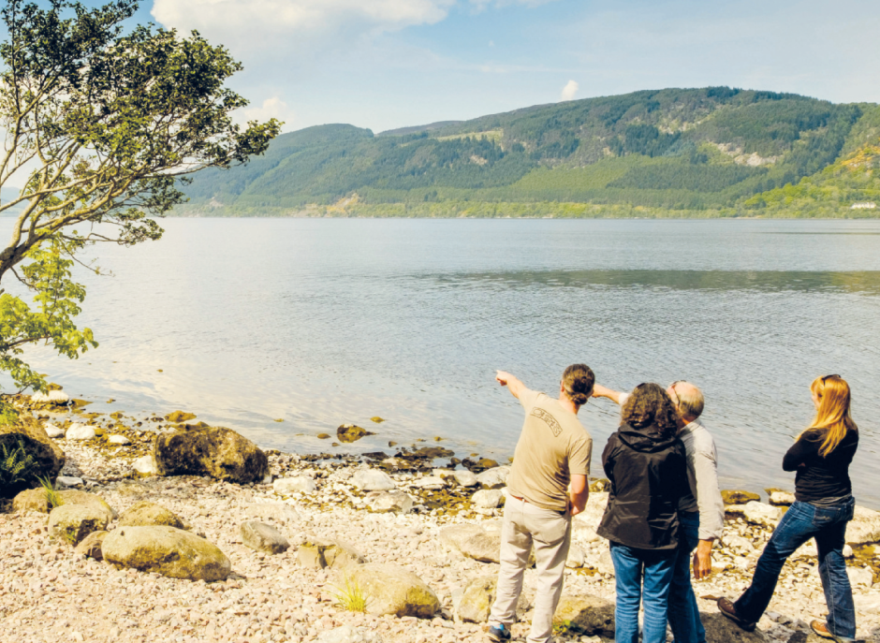
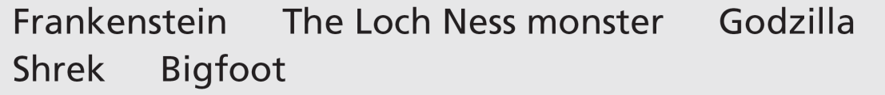
6f Encounters with a sea monster
Before you watch
1 How much do you know about these monsters? Compare your ideas with the class.
See next slide for answers
What could that be?
6f-p. 79

Slide 61
Exercise 1
EXAMPLE ANSWERS
Frankenstein: Victor Frankenstein is a young scientist who creates a monster in Frankenstein: or, the Modern Prometheus, a novel written by English author Mary Shelley in 1818. In films, the monster is often shown as huge, tall and slow-moving.
The Loch Ness monster: Loch Ness is a long, deep lake in Scotland. Legend has it that there is a monster in the loch. There are photographs showing what seems to be a dinosaur-like monster but nothing has been proved despite many investigations.
Godzilla: This is a fictional giant monster originating from a series of tokusatsu films of the same name from Japan. It first appeared in Ishiro Honda’s 1954 film Godzilla. It looks a bit like a T Rex dinosaur lizard. Bought to life by nuclear weapons testing, it destroys cities.
Shrek: Shrek is a friendly, green ogre. Shrek first appeared in a fairy tale picture book before the making of a 2001 American computer-animated fantasy-comedy film. He is voiced by Mike Myers.
Bigfoot: Bigfoot is the name given to a mythological apelike creature that is said to inhabit forests, mainly in the Pacific Northwest of the United States. Many consider sightings to actually be a bear (or a man in a gorilla suit).

Slide 62
2 Key vocabulary
a Read the sentences. Try to guess the missing words.
1 Don’t take the boat out past the red ____________.
2 Police talked to several ____________ who saw the accident.
3 Do camels have one ____________ or two?
4 Can you switch off the boat’s ____________, please? It’s very noisy.
5 It’s surprising how quickly submarines can ____________ into the water and disappear.
6 There were lots of seabirds following the ____________ of the ferry.
buoy
eyewitnesses
hump
motor
submerge
wake
6f-p. 79

Slide 63
b Read the words in bold and their definitions. The words are used in the video. Complete the sentences in Exercise 2a with the words.
a motor (n) an engine
b buoy (n) a coloured object that floats in water to indicate danger for boats
c eyewitnesses (n) people who see something happen, especially an accident, a crime, etc.
d hump (n) something that has a round shape and that sticks out
e wake (n) the waves behind something that moves through water
f submerge (v) to go under the surface of water
6f-p. 79

Slide 64

While you watch
3 Work in pairs. Watch the first part of the video (0.00–0.51) with the sound OFF. You will see Bob Iverson explaining something he saw as an eyewitness. What do you think he’s saying to the reporter?
Students’ own ideas
4 Watch the video with the sound ON. You will hear three eyewitness reports in total from Bob Iverson, Marjory Neal and Richard Smith. Correct the factual mistakes in the sentences.
1 All three eyewitnesses saw the monster on different days.
2 Only one eyewitnesses saw three or more humps.
3 All three eyewitnesses were in different places.
4 Only two eyewitnesses were alone at the time.
All three eyewitnesses …
1 saw the monster on the same day.
2 saw three or more humps.
3 were in exactly the same place.
4 were alone at the time.
6f-p. 79

Slide 65
5 Work on your own. Watch the video again. Make notes to answer the questions for each speaker.
1 Where was the eyewitness?
2 What were the weather or water conditions like?
3 How far away from the eyewitness was the monster?
4 What did the monster do?
6 Work in groups of three. Compare your notes. Is there any information still missing? If you need to, watch the video again and check.
Richard Smith:
1 in a boat
2 a nice, clear day
3 very close (‘at point blank range’)
4 disappeared, then came up again
Bob Iverson:
1 in his garden looking out over the water
2 calm water, dead flat
3 three hundred yards away
4 it went up, then down, up, then down, and then it was gone
Marjory Neal:
1 on her sundeck 2 no information
3 twenty or thirty feet beyond the mooring buoy
4 went across her view, then went down leaving a massive wake
6f-p. 79

Slide 66
Videoscript
Encounters with a sea monster
Part 1
0.00–0.51 Bob Iverson In August of 1997 I was sitting there, just looking out over the water. The water was absolutely dead flat calm, even calmer than it is now. All of a sudden three or four humps came up and then they went down and then they were up and then they were down. That caught my attention. Then I saw it two or three hundred yards up towards the green buoy there and that’s what really made me wonder what it was because of the speed going from that point to that point. And it was gone.
Part 2
0.52–0.59 Narrator Seven years later only seven miles away, another unlikely monster spotter was on her sundeck.
1.00–1.37 Marjory Neal It happened, I would say, anywhere between twenty and thirty feet behind the mooring buoy, that’s when I first saw it. It went right across my view and then all of a sudden it went down. But there was nothing else out here and it left this massive wake.
I knew I wasn’t dreaming when I saw the wake. It took up the total view that we can see from our deck.
1.39–1.49 Narrator A few miles east and twenty years before, another encounter. And this time at point blank range.

Slide 67
Videoscript
Encounters with a sea monster
1.50–2.40 Richard Smith It was March and it was a nice clear day, so I came out here with a friend visiting.
As we were going out, there were two humps in the water. So I headed off towards it and it submerged. I judged roughly where it had disappeared, turned the motor off and let it coast towards it. And while we still, while we were moving, it came up again, two humps in the water like tractor tyres. We could have touched the thing we were so close.
2.41–2.53 Narrator Three upstanding citizens, three remarkable stories. But are there more plausible explanations before we cry Sea Monster?

Slide 68
After you watch
7 Work in groups of three. Read what the reporter says at the end of the video. Discuss your ideas for possible explanations.
‘… three remarkable stories, but are there more plausible explanations before we cry “sea monster”?’
EXAMPLE ANSWERS
Plausible explanations for ‘Nessie’: an unusually large eel (long, snake-like fish), the wake of a large bird taking off from the water, a Greenland shark, smaller animals such as otters seen in such a way that they look bigger, misshapen trees in the water, a mirage or optical effect on the water, gases coming from the water, a hoax (there have definitely been hoaxes – perhaps local people have tried to attract tourists by making a hoax Nessie and photographing it)
6f-p. 79

Slide 69

8 Vocabulary in context
a Watch the clips from the video. Choose the correct meaning of the words and phrases.
b Complete the sentences in your own words. Then work in pairs and compare your sentences.
1 I was on my way to class once when all of a sudden …
2 Sometimes when I watch TV, I wonder …
3 I spend anywhere between … hours studying English each week.
4 A news story about ... caught my attention last week.
EXAMPLE ANSWERS
1 I was on my way to class once when all of a sudden it started to rain / I fell over.
2 Sometimes when I watch TV, I wonder what is happening to the world / whether there isn’t anything better to do.
3 I spend anywhere between 10 to 12 / 13 to 82 hours studying English each week.
4 Students' own ideas
6f-p. 79

Slide 70
Videoscript
Encounters with a sea monster
c
b
c
a
c
1 All of a sudden, these three or four humps came up ...
a at the same time
b slowly and quietly
c very quickly, with no warning
2 ... they were up and then they were down. That caught my attention.
a I didn’t understand.
b I noticed it.
c It looked at me.
3 ... that’s what really made me wonder what it was because of the speed ...
a believe it
b identify it
c question it
4 It happened, I would say, anywhere between twenty and thirty feet behind the mooring buoy ...
a approximately twenty or thirty
b less than twenty or thirty
c more than twenty or thirty
5 ... another encounter. And this time at point blank range.
a a long way away
b at an unknown distance
c extremely close

Slide 71
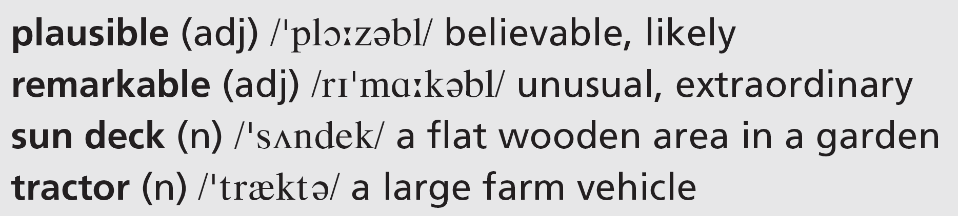
9 Would you believe a friend if they told you a story like the ones in the video? Why? / Why not?
6f-p. 79

Slide 72
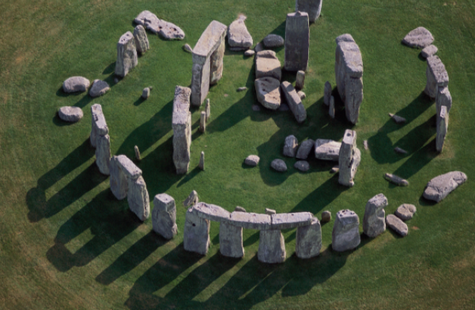
UNIT 6 REVIEW AND MEMORY BOOSTER
Grammar
1 Choose the correct options in the text about Stonehenge.
Stonehenge dates from 3–4,000 years ago. Although there 1 are / might be no written records from that period, some people think Stonehenge 2 can’t have / might have been part of King Arthur’s court. Others say invaders from Denmark 3 couldn’t have / could have built it or it 4 can / could be the ruins of a Roman building. The larger stones weigh 25 tons and they come from about 30 kilometres away from the site. The smaller stones originate from Wales, 230 kilometres away.
U6 Review-p. 80

Slide 73
Stonehenge 5 is / may be in the shape of a circle and the stones are placed 6 so that / to they match the sun’s highest and lowest points in the sky. This has led people to suggest that it 7 can’t have / could have been a scientific observatory or it was designed 8 for / to help aliens land. On the other hand, others believe it 9 can / may be a kind of cemetery – a place 10 for / so that burying people. Every year brings new theories about the true purpose of Stonehenge.
2 Answer the questions about the text in Exercise 1.
1 What are three theories about the origins of Stonehenge?
2 What is known about the stones?
3 What are three theories about the purpose of Stonehenge?
See next slide for answers
U6 Review-p. 80

Slide 74
Exercise 2
1 a It might have been part of King Arthur’s court.
b Invaders from Denmark could have built it.
c It could be the ruins of a Roman building.
2 The larger stones weigh 25 tons and they come from about 30 kilometres away from the site. The smaller stones originate from Wales, 230 kilometres away. Stonehenge is in the shape of a circle and the stones are placed so that they match the sun’s highest and lowest points in the sky.
3 a It could have been a scientific observatory.
b It was designed to help aliens land.
c It may be a kind of cemetery.

Slide 75

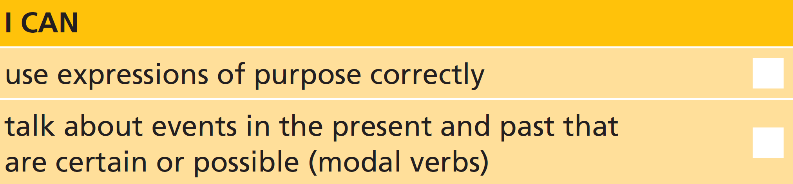
3 Work in pairs. Which theory about Stonehenge do you think is the most likely? Give reasons.
U6 Review-p. 80

Slide 76
Vocabulary
4 Complete the sentences with an adverb ending in -ly. The first letter is given.
1 I’d love to come for lunch, but u__________________ I’m busy that day.
2 You need to reply to this letter i__________________. It’s urgent.
3 Oh dear, I’ve a__________________ deleted the email. How did that happen?
4 I’m working t__________________ as the manager while my boss is away.
5 We checked our records and a__________________ the package was posted on 2 May.
6 I think the boys arrived late d__________________ to miss the test.
unfortunately
immediately
accidentally
temporarily
apparently
deliberately
U6 Review-p. 80

Slide 77
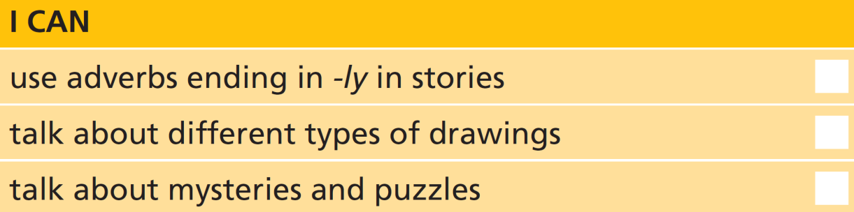
5 Work in pairs. Answer as many questions as you can. The words in bold are in Unit 6.
1 What are false eyelashes?
2 What do you understand by the expression ‘flexible thinker’?
3 When might you get a reward?
4 Name two activities you could do all day long.
5 How many shapes can you name?
6 Are lines always straight?
7 Give examples of how to use record as a noun and as a verb.
8 Is a hoax a person?
9 What’s the difference between a trick and a puzzle?
10 What do you use a spade for?
See next slide for answers
U6 Review-p. 80

Slide 78
Exercise 5
EXAMPLE ANSWERS
1 They are eyelashes that are not real / ones you put on and take off.
2 A flexible thinker is someone who can solve problems that don’t have a clear answer.
3 You might get a reward when you do something well and receive something in return, e.g. you find something and return it to the police/owner.
4 Students’ own answers, for example: sleep, sunbathe, relax, watch TV
5 Students’ own answers, for example: circle, rectangle, square, triangle, oval, sphere, star, cube, diamond, pentagon, hexagon, etc.
6 no
7 Students’ own answers, for example: She broke the world record. (noun), He’s recorded a new song. (verb), She’s got some cycling records. (noun), I’ve made a record of our conversation. (noun)
8 No, a hoax is a thing, a plan to deceive someone.
9 A trick is something you do to deceive someone; a puzzle is an activity in which you have to put pieces together or answer questions using skill.
10 for digging

Slide 79

Real life
6 Complete the expressions for reacting to news.
1 __________ __________ __________ joking!
2 __________ off __________!
3 __________ __________ __________ on!
4 __________ __________ __________ right!
5 __________ __________ serious?
6 __________ __________ sure?
You
must
be
Come
it
You’re
having
me
That
can’t
be
Are
you
Are
you
7 Work in groups. Write surprising sentences about yourself (true and false). Take turns to read out your sentences. Use appropriate expressions to react to the sentences about the other people and try to find out which sentences are true.
U6 Review-p. 80

Slide 80
Communication activities
UNIT 6a Exercise 2, page 70
Well, clearly the matches are to light the candle with and we know that drawing pins are for attaching things to other things. But what about the box? Yes, it’s for holding the drawing pins. But you can also use it to hold the candle. And then you attach the box to the wall. Did you get it? Yes? Congratulations, you’re a flexible thinker.
p. 155

